Slide 1

Contract Types
&
Project Delivery Systems
INS4821 Construction Management
Prof. Dr. Zeynep IŞIK

Slide 2
CONTENTS
Types of Construction Contracts
Project Delivery Systems

Slide 3

A contract (agreement, pact, covenant, or deal) refers to the mutual and corresponding expression of intent by two parties for the purpose of achieving a legal outcome.
A contract is defined as a legal transaction that gives rise to obligations for multiple parties (two or more).

Slide 4
Essential Elements of the Contract
In principle, it is a transaction that is not subject to any formal requirements.
>>> It can be done verbally, in writing, or in an official manner.
It is an obligation-creating transaction.
>>> While imposing a debt obligation on one party, it grants a right to a claim to the other.

Slide 5
Scope of the
Agreement
The Purpose of the Agreement
  These are the responsibilities that a debt relationship imposes upon the parties.
  These responsibilities must be explained individually within the contract and brought into compliance with the law.
  Rights,
  Duties and responsibilities,
  is to ensure the distribution of risk.

Slide 6


Contract Management
The primary objective of contract management;
to effectively ensure that the contract achieves its objective, without exceeding the specified timeframe or falling into a dispute.
>>>In other words, it is the task of ensuring that the parties with obligations under a contract are able to fulfill those obligations.

Slide 7
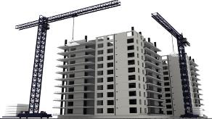

CONSTRUCTION CONTRACTS
A construction contract is an agreement in which a contractor undertakes to construct and deliver an immovable structure in exchange for a payment owed by the client.
Under this contract, the contractor undertakes the obligation to produce a construction work (a structure=building=construction), while the client undertakes the obligation to pay a price.

Slide 8
PARTIES TO THE AGREEMENT
Employer
It is the person who has the construction work carried out.
Contractor
This is the person who undertakes the construction of a work.
Natural Person: It is a legal term used for individuals to describe the entire span of time from conception—provided the person is born alive and fully formed—until their death.
Legal entity: In legal terms, an entity that arises from a collection of individuals or assets and is treated as a single person—such as a joint-stock company, a limited liability company, an association, a foundation, a trade union, or similar organizations—acquires legal personality the moment it comes into legal existence.

Slide 9
CLIENT (client)
CONTRACTOR (contractor)
CONSULTANT (consultant): A natural or legal person appointed by the employer, with specified powers, to manage the technical and/or administrative and/or financial aspects of the works and notified to the contractor; a party to the employer–consultant agreement.
SUPPLIER (supplier)
SUBCONTRACTOR (subcontractor)
FINANCIER (financier)
MEDIATOR (adjudicator): An impartial and independent person involved in resolving disputes and disagreements between two parties. The mediator’s decision is not binding.
DISPUTE BOARDS (Dispute Avoidance and Adjudication Board /DAAB): Their main purpose is to help prevent disputes and decide disputes that arise. Under FIDIC 2017 contracts, DAAB decisions must be implemented immediately. This obligation continues even if a party objects. Unless challenged within the specified period, the decision becomes final and binding.
ARBITRATION (arbitration): A private procedure outside the state courts in which parties refer an existing or potential dispute to an arbitral decision under their agreement. An arbitrator is a natural person authorized to conduct the proceedings and issue a decision under the applicable arbitration rules to resolve disputes between two parties.
Contract Mgmt. Parties

Slide 10
Types of Construction Contracts
By Financing Model
  Build-Operate-Transfer Contracts
  Construction in Exchange for Land Share
By Contractor Structure
  Business Alliances (Joint Venture, Consortium)
  Subcontracting
Consulting Engineering Agreement
Standard and Non-Standard Contracts
  Public Procurement Contract
  FIDIC
By Project Delivery System
  Traditional System
  Design-Build
  Engineering, Procurement and Construction (EPC)
  Construction Management
  Integrated Project Management
By Payment Method
  Unit Price
  Lump-Sum Price
  Cost Plus
By Scope of Work
  Turnkey Contracts
  Partial-Scope Contracts

Slide 11
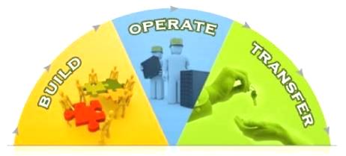
1. Contracts by Financing Model
1.1 Build-Operate-Transfer Contracts
(Build-Operate-Transfer: BOT)
“A special financing model developed for
public projects requiring advanced technology
and substantial financial resources,
in which the company recovers its investment, including profit,
through purchases by the administration or service users of the goods or services produced during the company’s operating period.”

Slide 12
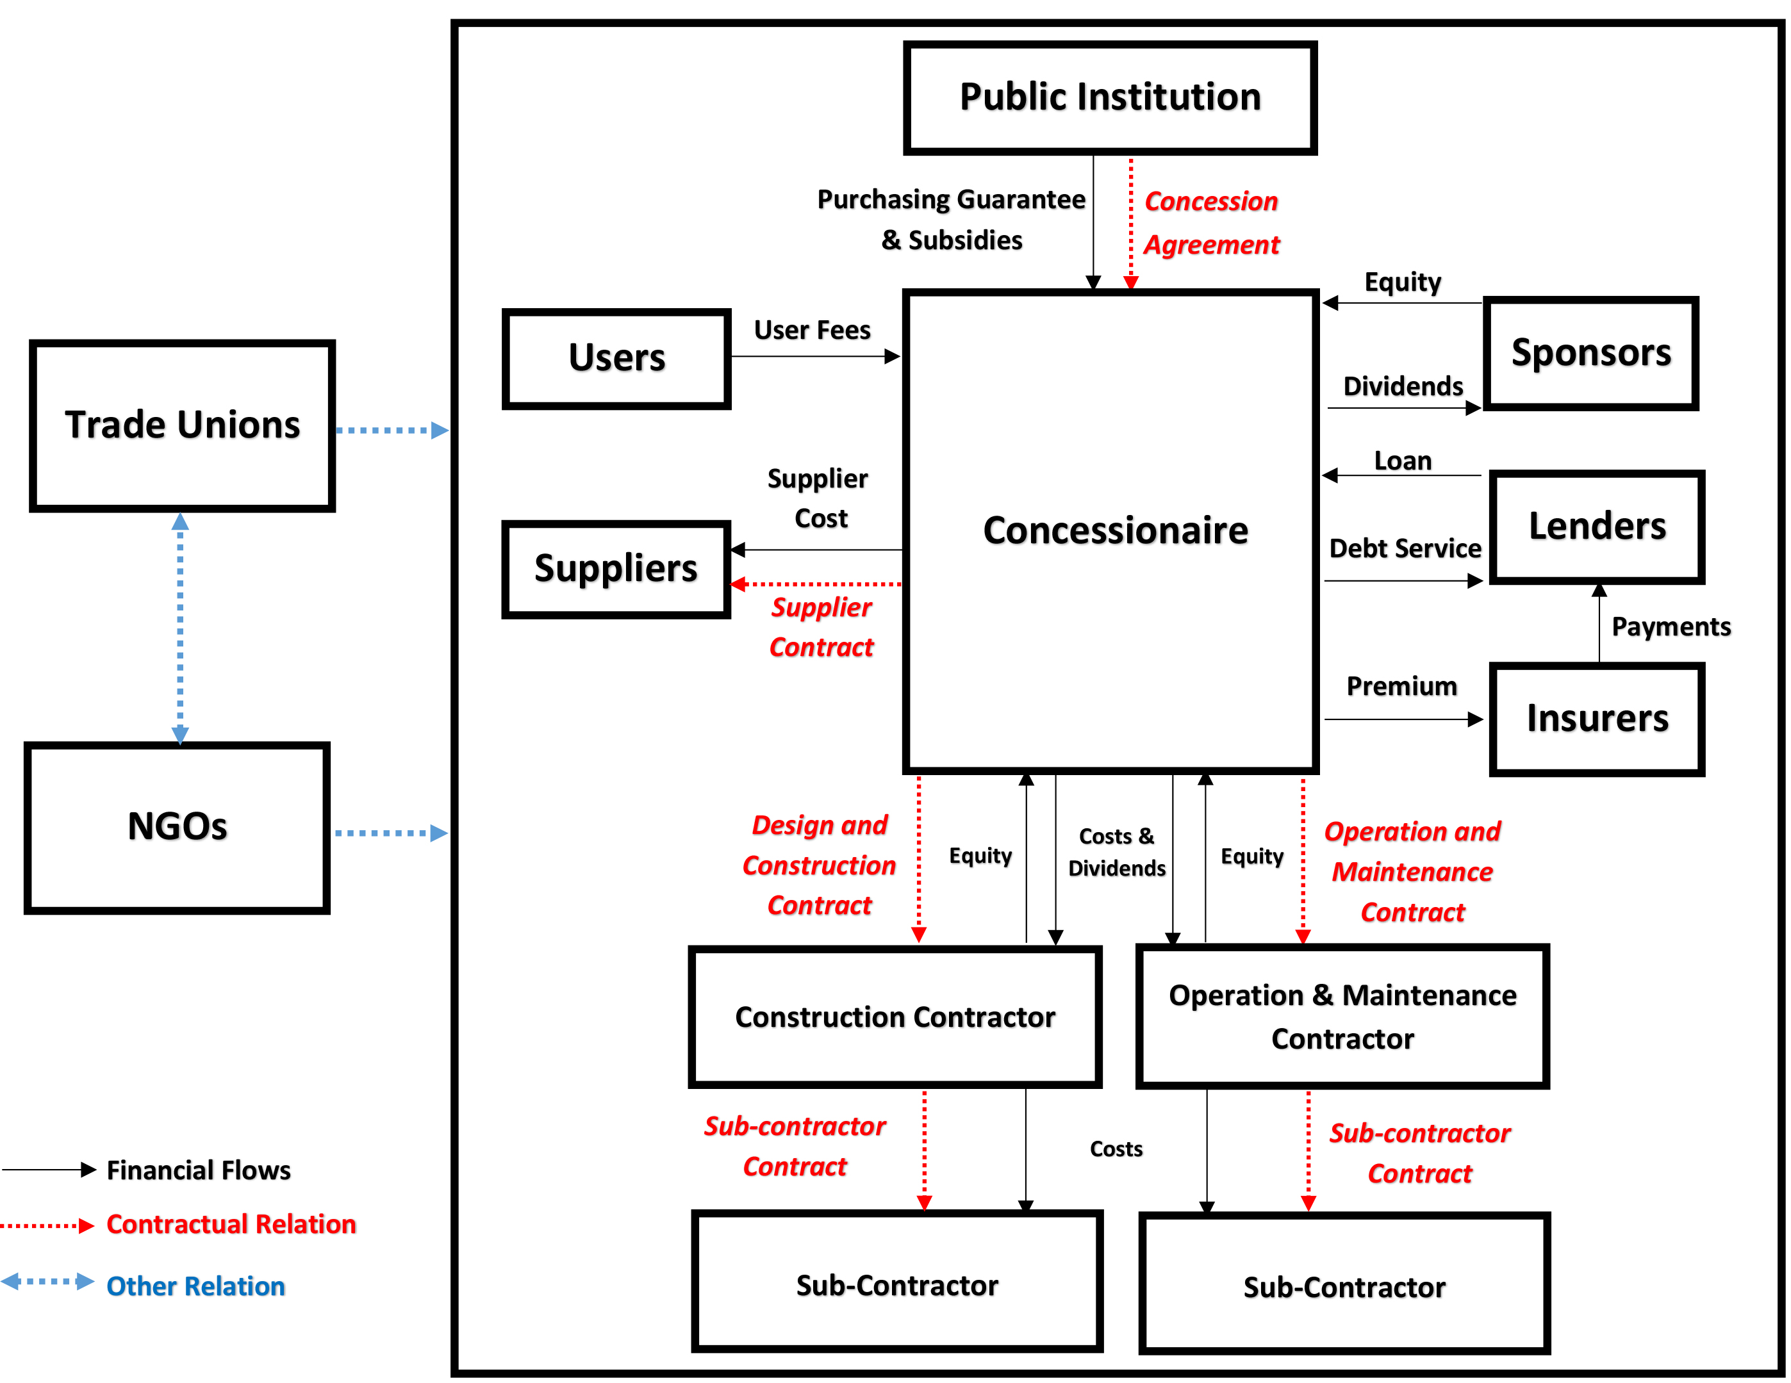
1. Contracts by Financing Model
1.1 Build-Operate-Transfer Contracts
Build-Operate-Transfer (BOT) type construction contract

Slide 13

1. Contracts by Financing Model
1.2 Construction in Exchange for Land Share
A construction contract in exchange for a land share, commonly known as construction in exchange for units, is signed between the landowner(s) and a contractor undertaking construction in return for a share of the land.
The contractor undertakes construction on the land, and the landowner promises to transfer the agreed number of independent units upon completion. The contractor therefore receives property rather than money as payment. This arrangement is known as construction in exchange for units or land.
(!) As the most widely used contract type
in the Turkish construction sector,
it is also the type most frequently subject to disputes.

Slide 14

2. Contracts by Contractor Structure
2.1 Business Alliances
A) Joint Venture:
In a Joint Venture (Joint Venture), companies pool their resources for a single project (financing, personnel, equipment and materials) to establish a company.
This company is responsible to the employer for the entire project.
The parties must share:
  A limited purpose and duration
  A common objective
  Joint management
  A partnership relationship.
Key Elements of a Joint Venture

Slide 15

B) Consortium:
Companies pool their resources for one or more projects while retaining their separate legal identities.
Once the contract is awarded, each consortium member is responsible to the employer for its own scope of work.
In a consortium, each member undertakes a specific part of the works. The contract must clearly specify the work to be carried out by each member.

Slide 16
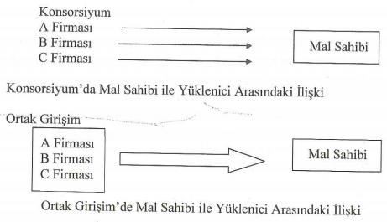
Consortium
Company A
Company B
Owner
Company C
Owner–Contractor Relationship in a Consortium
Joint Venture
Company A
Company B
Owner
Company C
Owner–Contractor Relationship in a Joint Venture

Slide 17
Difference Between a Joint Venture and a Consortium
In a Joint Venture, the partners are jointly and severally liable to the employer (all partners assume liability);
In a Consortium, each partner’s liability to the employer is limited to the work or section allocated to it in the contract.
 | Joint Venture | Consortium
Establishment of a New Company | A new company is established. | No new company is established. (each company retains its legal identity)
Number of Projects | For one project | For one or more projects
Liability | The joint company is liable for the entire project. | Each company is liable for its own part of the project.

Slide 18
2. Contracts by Contractor Structure
2.2 Subcontracting Agreements
These agreements establish legal relationships between the employer (owner/administration), the contractor and the subcontractor.
The employer has no direct contract with subcontractors;
however, the employer expects the main contractor to perform the works.
The main contractor may not engage a subcontractor without the administration’s approval.
Builder
Client
Subcontr.
Subcontr.

Slide 19

3. Consulting Engineering Agreement
An agreement between the employer and the consulting engineer* that imposes obligations on both parties.
*engineers and architects providing consulting services
Responsibilities of the Consulting Engineer
Feasibility and preliminary studies
Project design (preliminary and detailed designs)
Preparation of tender documents
Preparation of technical studies and specifications
Basic planning and preparation of financing schedules
Site supervision and inspection
Inspection of materials/workmanship
Progress monitoring and reporting
Provisional and final acceptance procedures, etc.

Slide 20



4. Standard Forms and Non-Standard Contracts
The general conditions of construction contracts usually follow a particular standard.
Depending on the scope of the construction project, these standards follow national specifications or standard forms prepared by international professional organizations.

Slide 21
COMMONLY USED STANDARD FORMS
FIDIC (Fédération Internationale du Batiment et des Travaux Publics) (International) Conditions of Contract for Civil Engineering Works | International Federation of Consulting Engineers
RIBA Form Royal Institute of British Architects | United Kingdom
ICE Contract Institute of Civil Engineers | United Kingdom
Overseas Civil Conditions of Contract - ACE Form Associtation of Consulting Engineers in the UK and Export Group for the Constructional Industries | United Kingdom
NEC New Engineering Contract | United Kingdom
RIAI Form Royal Institute of the Architects of Ireland | Ireland
EUC European Union Contract | EU
AIA CONTRACT American Institute of Architect | United States
Sample Contract of Engineering Advancement Association of Japan | Japan
KİK Standard Form of Contract for Construction Works | Türkiye

Slide 22
4. Standard and Non-Standard Contracts
4.1 Standard Contracts >>> Public Procurement Contract
Public Procurement Law No. 4734: This Law sets out the principles and procedures for procurement by public institutions and organizations governed by public law, under public supervision, or using public funds.
Public Procurement Contracts Law No. 4735: This Law sets out the principles and procedures for drafting and implementing contracts arising from procurement conducted under the Public Procurement Law.

Slide 23

4. Standard and Non-Standard Contracts
4.2 Standard Contracts >>> FIDIC Contracts
The complexity of construction contracts and their detailed technical provisions have led to the use of standardized rules in practice.
FIDIC was founded in Belgium in 1913.
Turkish contractors became familiar with FIDIC when they began working abroad in 1972.
The Association of Turkish Consulting Engineers and Architects joined FIDIC in 1987.
International Federation of Consulting Engineers
Federatıon Internatıonale Des Ingenieurs Conseils

Slide 24
Red Book
1999/2017
Conditions for Contactor for Construction
Pink Book
2010
Red Book adopted for Multilateral Development Banks (MDBs)
Yellow Book
1999/2017
Conditions for Contactor for Plant, Design-Built
Silver Book
1999/2017
Conditions for Contactor for EPC/Turnkey
FIDIC
Rainbow Suite
Orange Book
1995 (Merged with Yellow Book)
Conditions for Contactor for Design-Built and Turnkey
Gold Book
2008
Conditions for Contactor for Design-Built-Operate (DBO) (Maintainance)
Green Book
1999
Short form of Contract
Blue Book
2006/2016
Conditions for Contactor for Dredging works
White Book
1999/2006/2017
Client/Consultant Model Services Agreement- used to appoint consultants

Slide 25
Relationships Between
Construction Contract Stakeholders
5. Contracts by Project Delivery System
In a construction contract, stakeholders’ roles depend on the project delivery system.
Selecting a project delivery system involves deciding the number of contracts: whether the project will have a single contractor or multiple contractors.

Slide 26
5. Contracts by Project Delivery System
Single-Contractor Contracts
This is a widely used contract arrangement. The owner agrees with a single selected contractor. A design contract governs the agreement between the contractor and the architect/engineer.
  Contractor–subcontractor: subcontracting agreements
  Contractor–supplier: supply contract
  Architect/engineer: consultancy agreements
  Contractor–owner: construction contract
  Architect/engineer–owner: design contract

Slide 27
5. Contracts by Project Delivery System
Multiple-Contractor Contracts
Multiple-contractor arrangements are generally preferred when needed.
  For example, in a building project, separate contracts for work packages (structural, finishing, electrical and mechanical works) may be used at the owner’s request.
  Under these contracts, the owner or project manager is responsible for providing all necessary coordination.
  Compared with single-contractor contracts, the owner’s coordination role is more important.

Slide 28
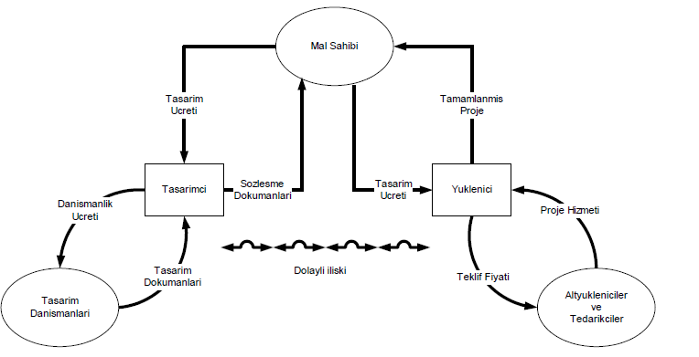
5. Contracts by Project Delivery System
Design - Bid - Build (Design-Bid-Build / DBB)
Owner
Contract Model: The traditional system. The employer first signs a Design Contract with an architect/engineer. Once the design is complete, the works are tendered and a Construction Contract is signed with the contractor.
Payment Method: Usually Unit Price or Lump-Sum contracts.
Key Feature: Design and construction are clearly separated; the employer deals with two separate parties.
Design
Fee
Completed
Design
Contract
Documents
Design
Fee
Designer
Construction
Contractor
Consulting
Fee
Project Services
Design
Documents
Indirect Link
Bid Price
Design
Consultants
Subcontractors
and
Suppliers

Slide 29
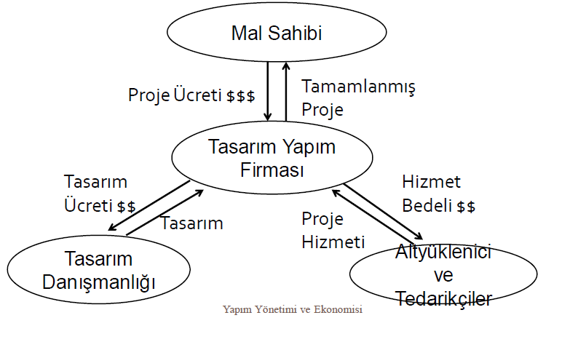
5. Contracts by Project Delivery System
Design - Build (Design-Build / DB)
Owner
Contract Model: Design and construction services are awarded to a single contractor (a consortium or integrated company) under one contract (e.g., FIDIC Yellow Book).
Payment Method: Usually a turnkey lump sum.
Key Feature: The employer has a single point of contact; conflicts over liability for design and construction defects are eliminated.
Design Fee $$$
Completed
Design
Contractor:
Design + Construction
Design-Build
Company
Design
Fee $$
Service
Fee $$
Design
Project
Services
Design
Consultancy
Subcontractors
and
Suppliers
Construction Management and Economics

Slide 30
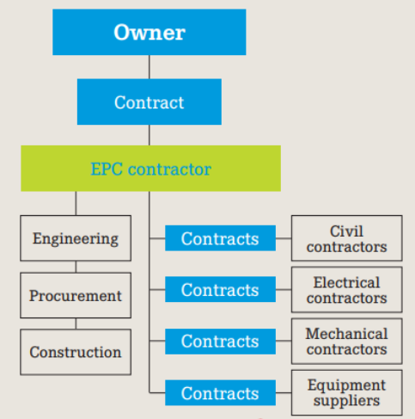
5. Contracts by Project Delivery System
Engineering, Procurement and Construction
(Engineering, Procurement, and Construction / EPC)
Contract Model: Generally used for “Turnkey” projects. Engineering, equipment/material procurement and construction are all assigned to a single contractor (e.g., FIDIC Silver Book
Payment Method: Predominantly fixed lump sum
Key Feature: The facility is delivered operational and compliant with performance criteria, with most risks transferred to the contractor.
Notes:
Engineering covers detailed design work, technical drawings, and equipment specifications.
Procurement handles sourcing, purchasing, and logistics of all materials and equipment.
Construction is the physical on-site work, including civil foundations, piping, electrical systems, and instrumentation.
Who Holds Risk Contractor (fixed price)
Owner Involvement Low
Best Suited For plants, refineries, power projects where cost certainty is required

Slide 31
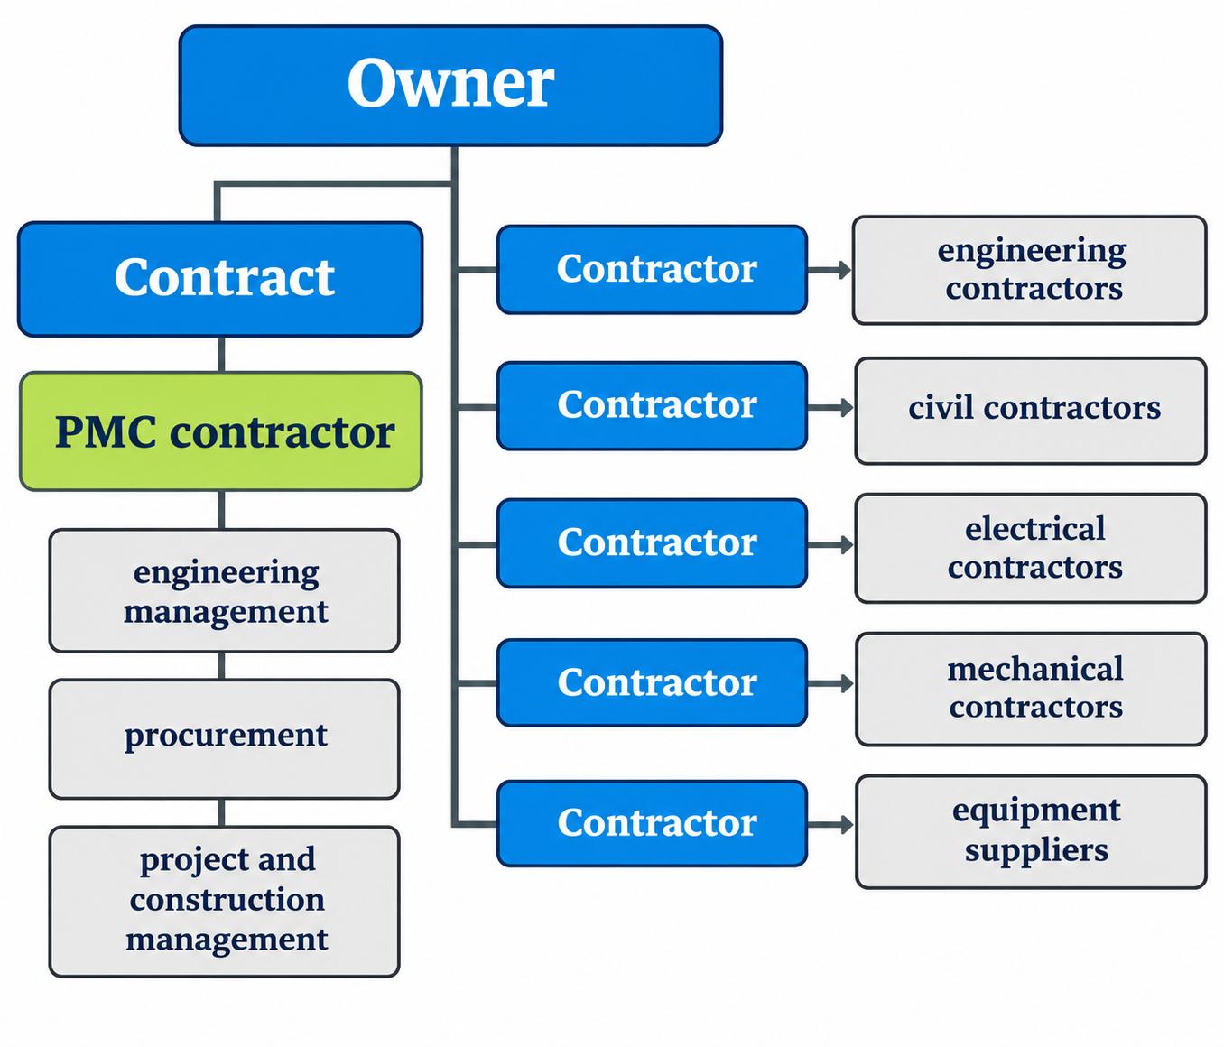
5. Contracts by Project Delivery System
Construction Management
(Project Management Consultancy)
Contract Model: The employer signs a consultancy agreement with a construction management consultant, who coordinates and manages design, tendering, procurement and construction on the employer’s behalf. Construction work may be awarded to multiple contractors under separate contracts.
Key Feature: The employer retains control over the project, while a professional team coordinates the various contractors. As construction is not consolidated under a single main contractor, coordination and interface risks become important for the employer.
Notes:
Project Management Consultancy focuses on high-level advisory services, often used for feasibility studies or project oversight
Who Holds Risk Owner
Owner Involvement very high
Best Suited For Owners with internal capability who want an expert to coordinate multiple contractors

Slide 32
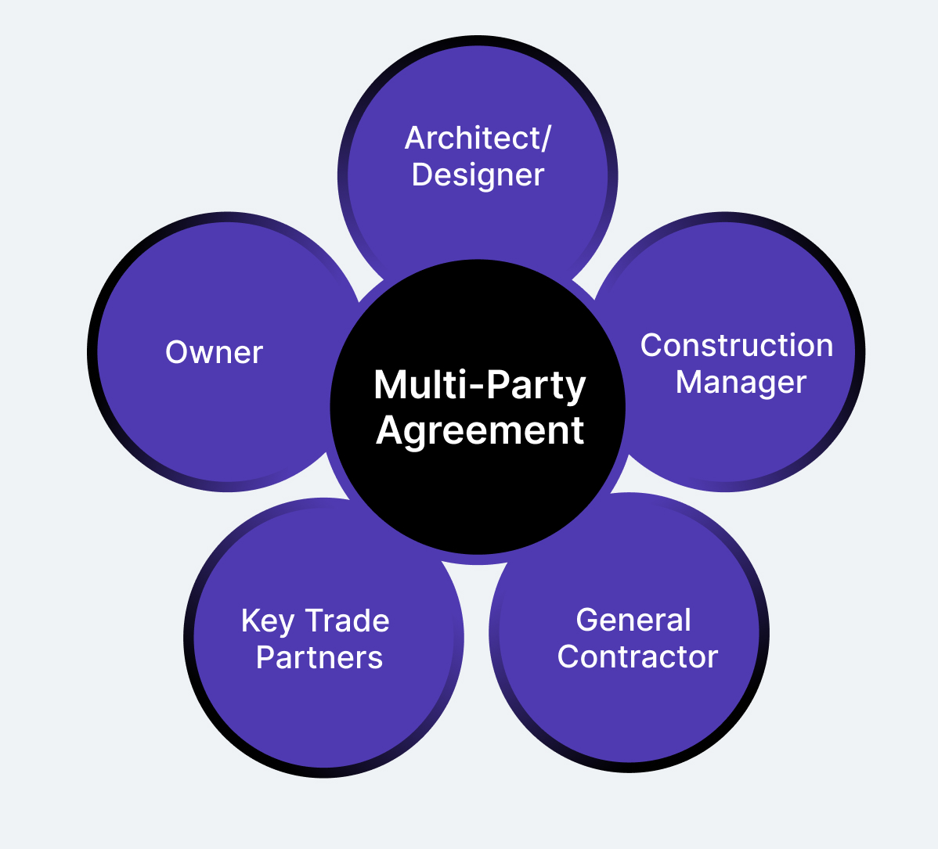
5. Contracts by Project Delivery System
Integrated Project Delivery (IPD)
Contract Model: A collaborative arrangement bringing the employer, designer and main contractor together under a single shared multi-party contract.
Key Feature: Risks and profits are shared by all parties in a common pool; the aim is to eliminate disputes and litigation risks

Slide 33
6. Contracts by Payment Method
  Unit Price Contracts
  For construction works, a unit price contract is based on the total obtained by multiplying each item’s quantity in the administration’s schedule by the bidder’s proposed unit price. The schedule is based on preliminary or final designs, associated schedules of works and unit price descriptions.
*** The 2026 Unit Prices were published by the Ministry of Environment, Urbanization and Climate Change
on 03 March 2026.

Slide 34
  * This method can be used where unit price descriptions and specifications are clear, but the project is still being designed.
  * Unit prices include materials, labor, expenses and the contractor’s profit.
  * Under this contract, the contractor is paid according to the quantities of work executed during construction.
  * To determine the payment due, the quantities completed during the period are first measured. Each quantity is then multiplied by its unit price, and the resulting amounts are added together.
  >>> Payments are based on progress valuations rather than milestones.
  * For example, if the contractor completes A m³ of excavation, B m³ of concrete and C m³ of stone masonry in a payment period, at unit prices a, b and c respectively, the payment (K) is calculated as follows.
  K = (A x a) + (B x b) + (C x c)

Slide 35
6. Contracts by Payment Method
  Lump-Sum Contracts
  The bidder offers the owner a single price for the entire work. At this price, the bidder undertakes to complete the tendered works in accordance with the detailed design, schedules of works and technical specifications.
  This contract type is preferred in Turkish public procurement, as stipulated by law.

Slide 36
  * This contract type is more appropriate when a detailed design is available and the conditions involve less uncertainty.
  * As there is no agreement on separate unit prices for each item, payments are made at specified milestones. >>> For example: 30% advance at commencement, 40% after structural completion, 25% after provisional acceptance and 5% after final acceptance.
  * Under a lump sum, the contractor generally bears the risk of costs exceeding the agreed price. A price increase or contract termination may be requested only if extraordinary circumstances cause costs to rise excessively.

Slide 37
6. Contracts by Payment Method
  Cost-Reimbursable Contracts (Cost Plus Profit)
  When the cost of the works is unknown, the contractor and investor agree before signing the contract on a payment formula based on actual costs, without specifying a fixed price. The contractor receives profit calculated as a stated percentage of the costs specified in the contract.
For example, if the profit rate is 15% and the contractor’s work costs TRY 10,000, the payment is calculated as: 10,000 + (10,000 x 15%) = TRY 11,500.
For this procurement method, it is therefore important to define which expenses are included in the cost, how they will be documented and the applicable profit rate. The parties must clarify these matters and include them in the contract before construction begins.

Slide 38
  * Under Cost Plus Profit procurement, the profit rate is predetermined, preventing attempts to increase profit by reducing costs.
  However, as the contractor’s profit is a percentage of cost, unnecessary spending and material waste may increase, artificially raising costs to generate more profit.
  When drafting these contracts, measures to minimize such adverse effects must therefore be considered.
  * Suitable when designs are not yet finalized, the employer has little construction expertise, or the employer wants to know exactly how much profit will be paid to the contractor.
  * Financially, this contract type carries the lowest risk for the contractor, who earns profit on whatever is spent. In this sense, the risk is zero. It is also the most financially uncertain contract for the employer.
  * Payments are based on progress valuations rather than milestones.

Slide 39
7. Contracts by Scope of Work
  Turnkey (used for an entire project): Turnkey means completing all work from A to Z, starting with the site and including excavation, structural and finishing works, electrical and mechanical installations, infrastructure and landscaping.
  Partial Works: Large corporations that invest continuously and have an internal construction management department may use this method to avoid a main contractor’s profit margin. Instead of awarding a turnkey contract, the owner manages the project and subcontracts each work package separately. These are partial-scope contracts, such as excavation or structural works contracts. Agreements between main contractors and subcontractors are also of this type.

Slide 40


